Slide 1
Lecture-5
Managing the Information Systems Project

Slide 2
Learning Objectives
Explain the process of managing an information systems project.
Describe the skills required to be an effective project manager.
List project management activities during project initiation, planning, execution, and closedown.
Explain critical path scheduling, Gantt charts, and Network diagrams.
Explain the utility of commercial project management software tools.

Slide 3
Importance of Project Management
Project management may be the most important aspect of systems development.
Effective PM helps ensure
Meeting customer expectations
Satisfying budget and time constraints
PM skills are difficult and important to learn.

Slide 4
Deciding on Systems Projects
System Service Request (SSR)
A standard form for requesting or proposing systems development work within an organization.
Feasibility Study
A study that determines whether a requested system makes economic and operational sense for an organization.

Slide 5
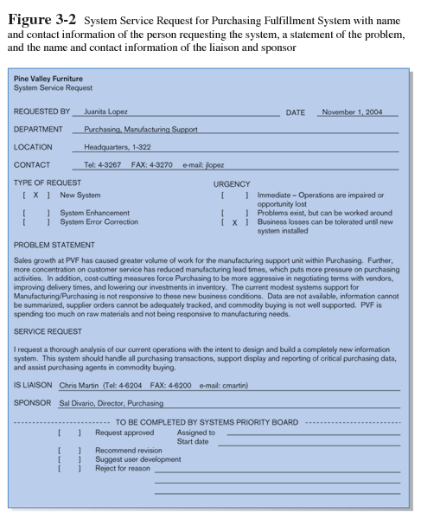
System Service Request (SSR)
System Service Request (SSR) is a form requesting development or maintenance of an information system. It includes the contact person, a problem statement, a service request statement, and contact information.

Slide 6
Managing the Information Systems Project
Project:
A planned undertaking of related activities to reach an objective that has a beginning and an end.
Project Management:
A controlled process of initiating, planning, executing, and closing down a project.
Project Manager
Systems analyst with management and leadership skills responsible for leading project initiation, planning, execution, and closedown
Deliverable
The end product of an SDLC phase

Slide 7
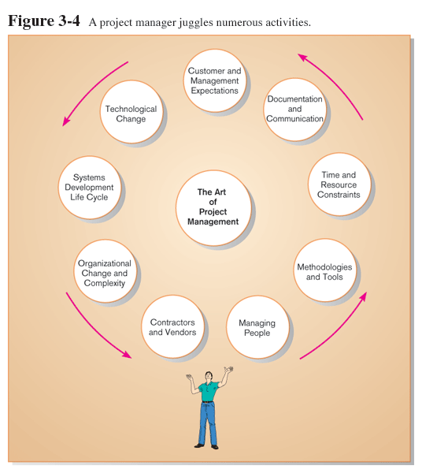
Project Management Activities

Slide 8
Phases of Project Management Process
Phase 1: Initiation
Phase 2: Planning
Phase 3: Execution
Phase 4: Closedown

Slide 9
Representing and Scheduling Project Plans
Gantt Charts
Network Diagrams
PERT Calculations
Critical Path Scheduling
Project Management Software

Slide 10
Gantt Charts vs. Network Diagrams
Gantt Charts
Show task durations.
Show time overlap.
Show slack time in duration.
Network Diagrams
Show task dependencies.
Do not show time overlap, but show parallelism.
Show slack time in boxes.

Slide 11
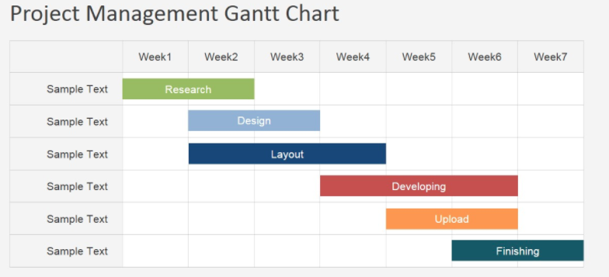
Example of Gantt Chart

Slide 12
Estimating Task Duration
PERT: Program Evaluation Review Technique
Technique that uses optimistic (o), pessimistic (p), and realistic (r) time estimates to determine expected task duration
Formula for Estimated Time:
ET = (o + 4r + p)/6

Slide 13
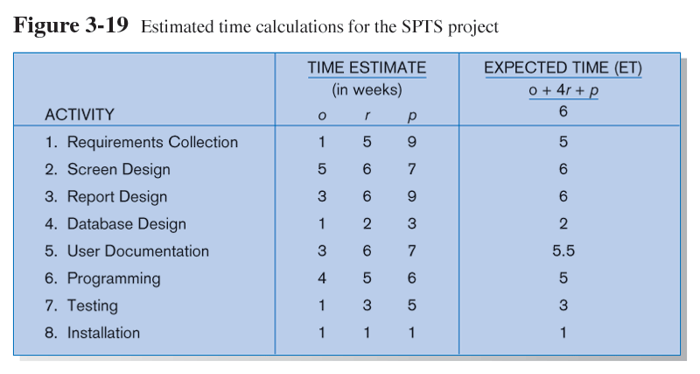
Example PERT Analysis

Slide 14
Critical Path Scheduling
A scheduling technique whose order and duration of a sequence of task activities directly affects the completion date of a project
Critical path: the shortest time in which a project can be completed
Slack time: the time an activity can be delayed without delaying the project

Slide 15
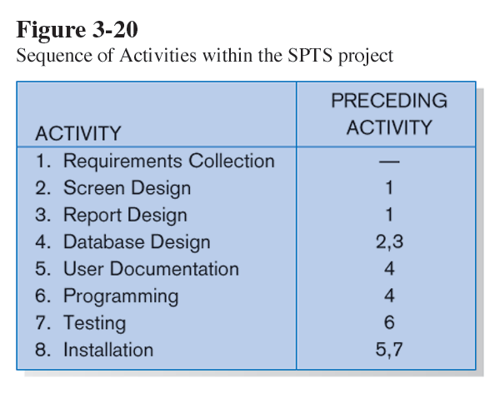
Critical Path Example (dependencies between tasks)
PRECEDING ACTIVITIES indicate the activities that must be completed before the specified activity can begin.

Slide 16
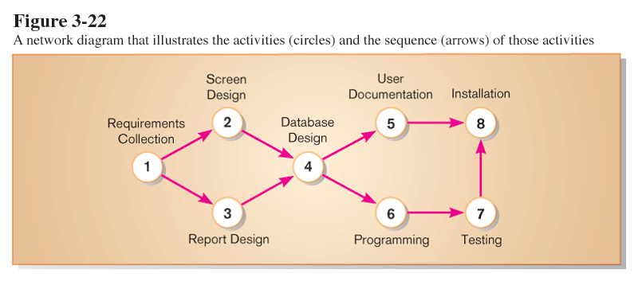
Critical Path Example
Network diagram provides graphical illustration of dependencies between activities (see previous slide).
Network diagram shows dependencies

Slide 17
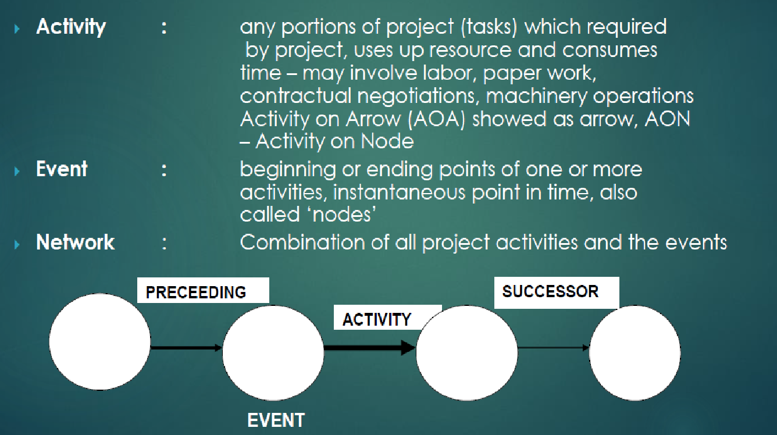
Critical Path Elements

Slide 18
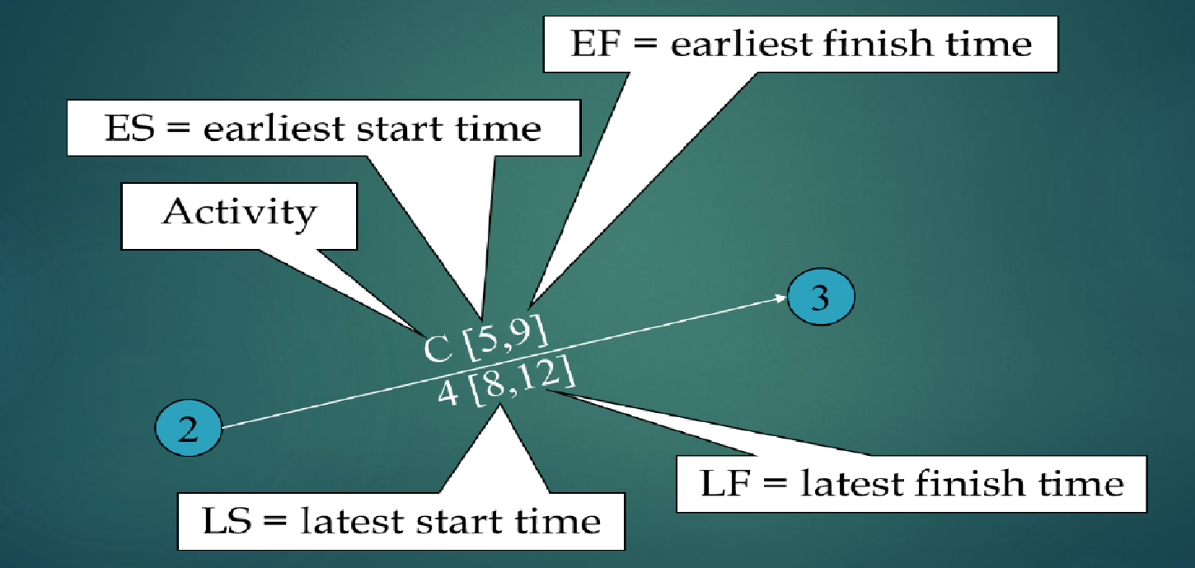
Activity, Duration, ES, EF, LS, LF

Slide 19
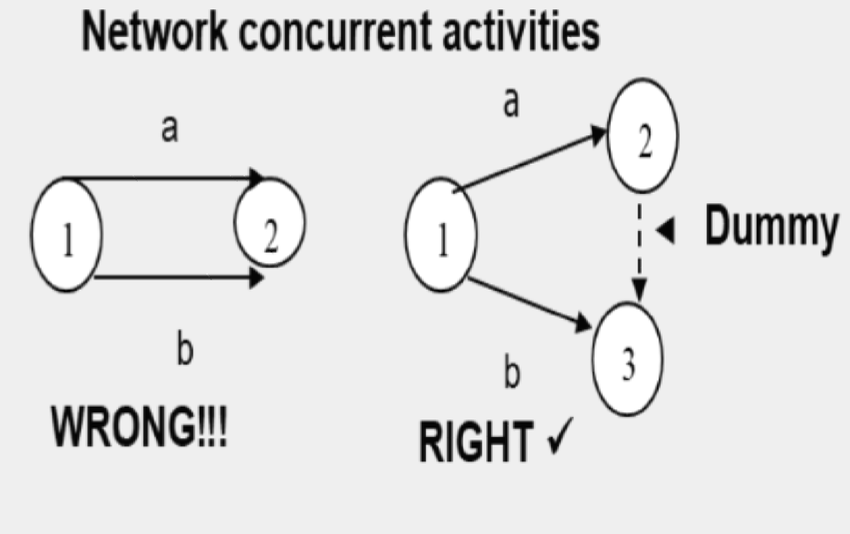
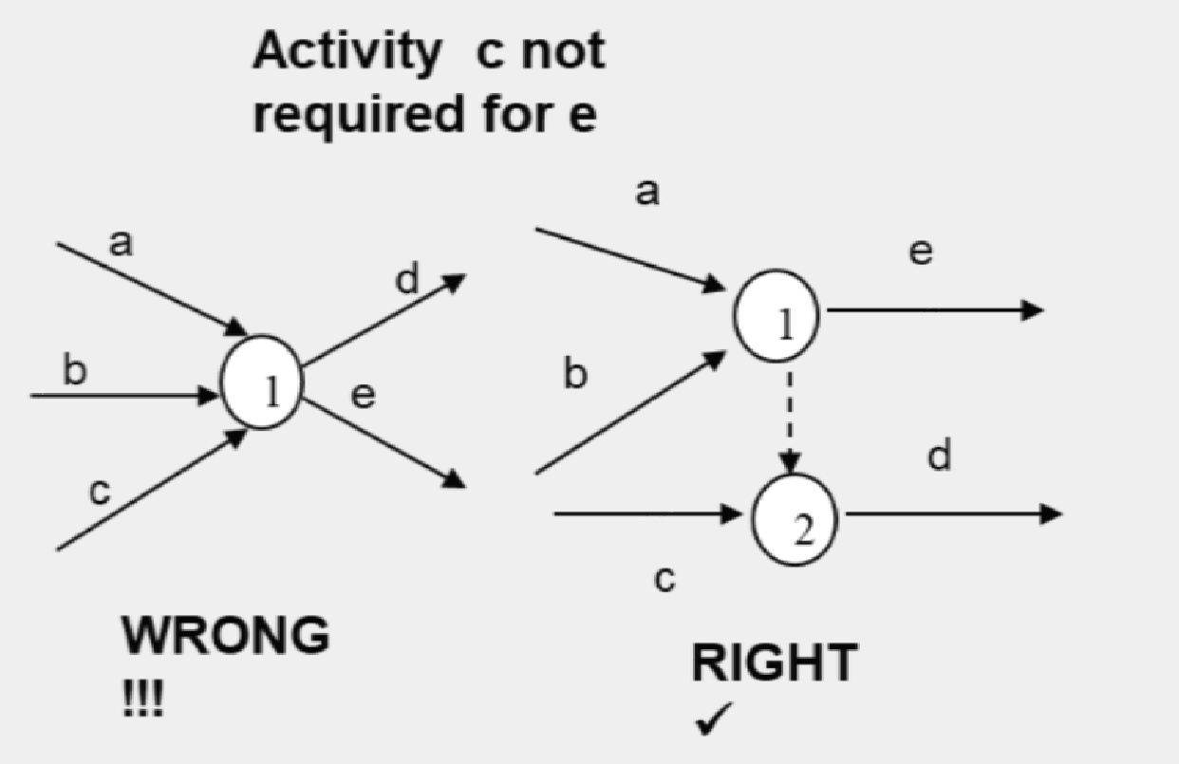
Dummy Activity
This dotted arc is a dummy activity. Dummy activities often have a zero completion time and are used to represent precedence relationships that cannot be easily (if at all) represented using the actual activities involved in the project.
By convention dummies are always shown as dotted arcs in network diagrams.

Slide 20
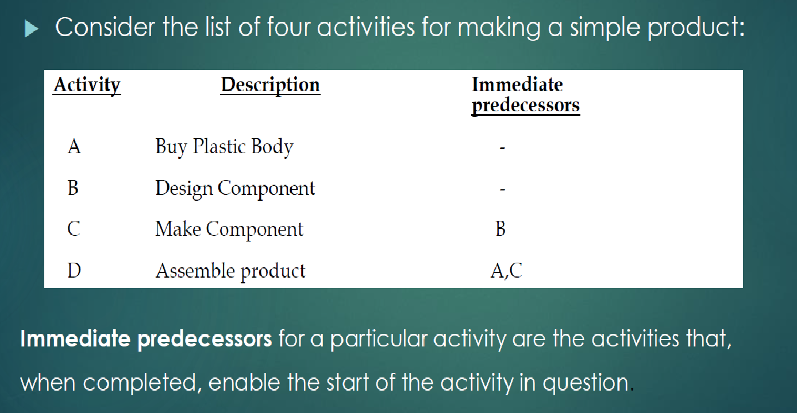
Example-1: Simple Network

Slide 21
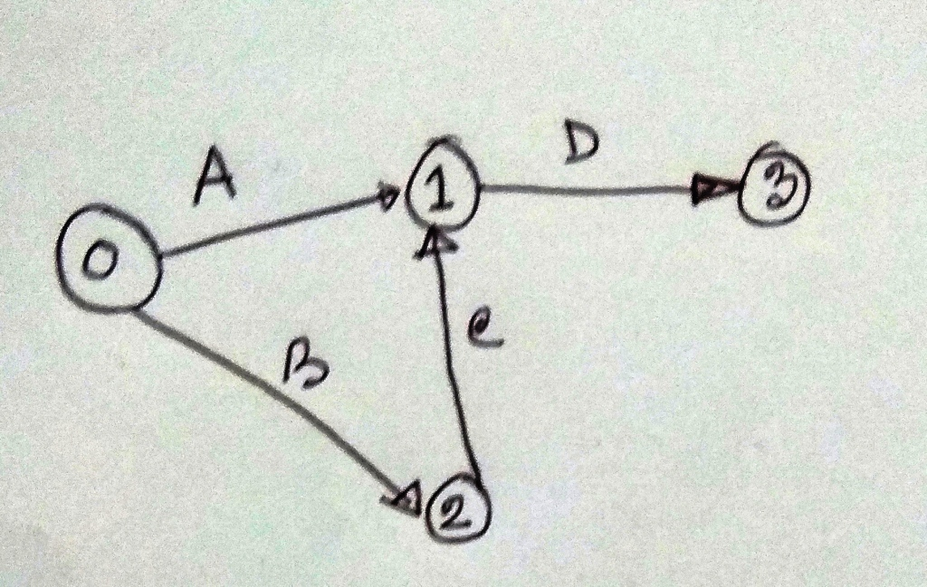
Network Diagram

Slide 22
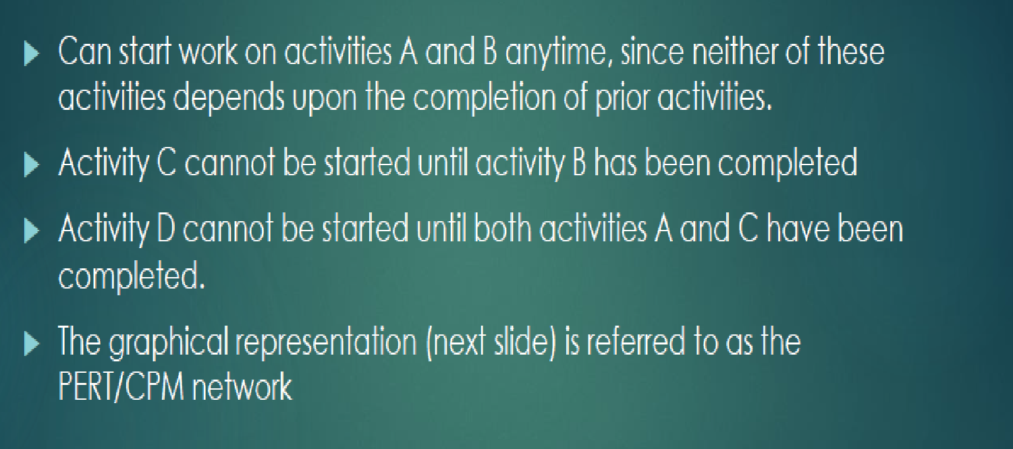
Sequence of Activities

Slide 23
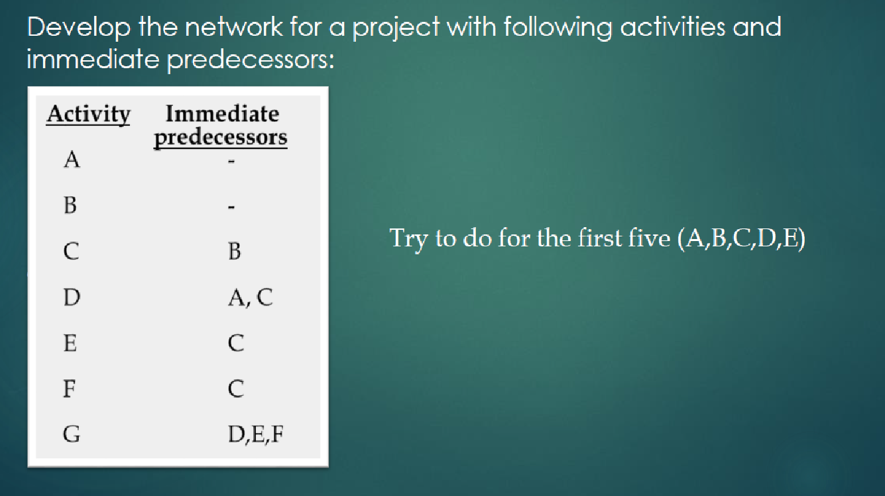
Example-2: Simple Network

Slide 24
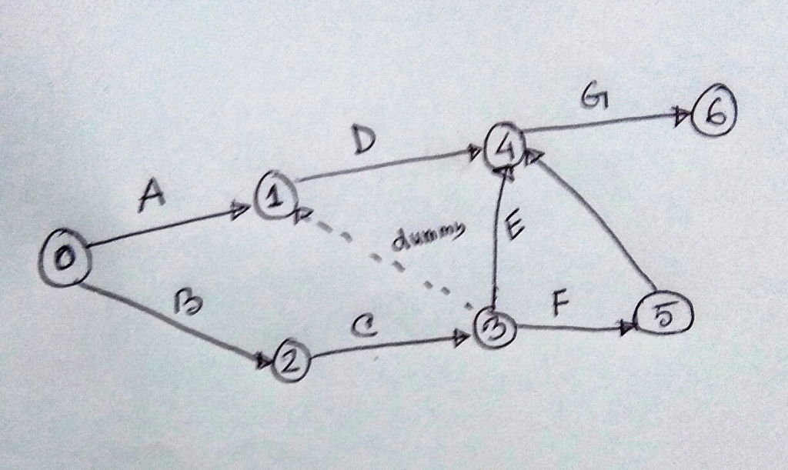
Network Diagram

Slide 25
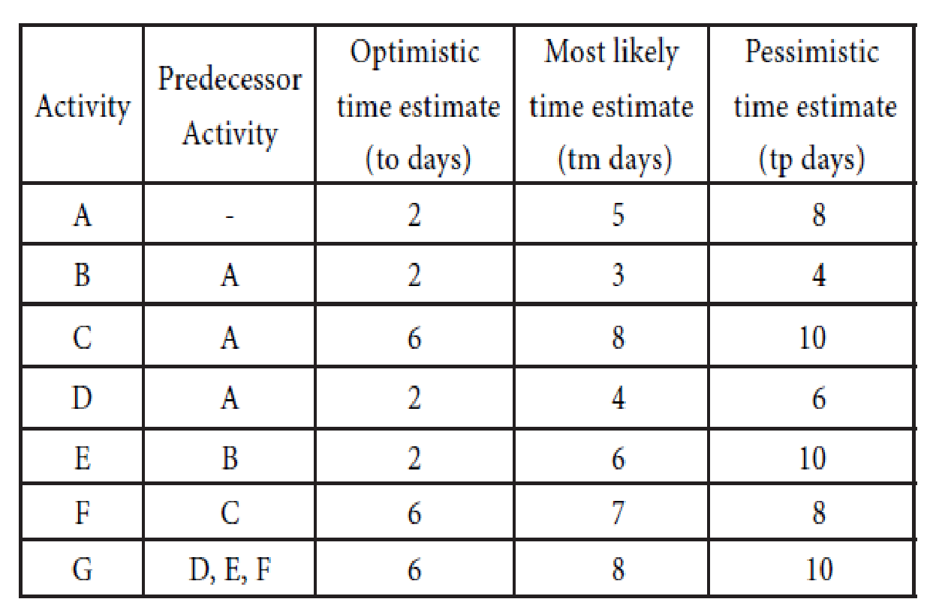
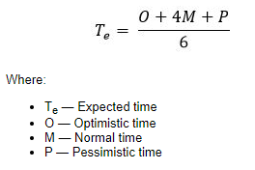
Data Table

Slide 26
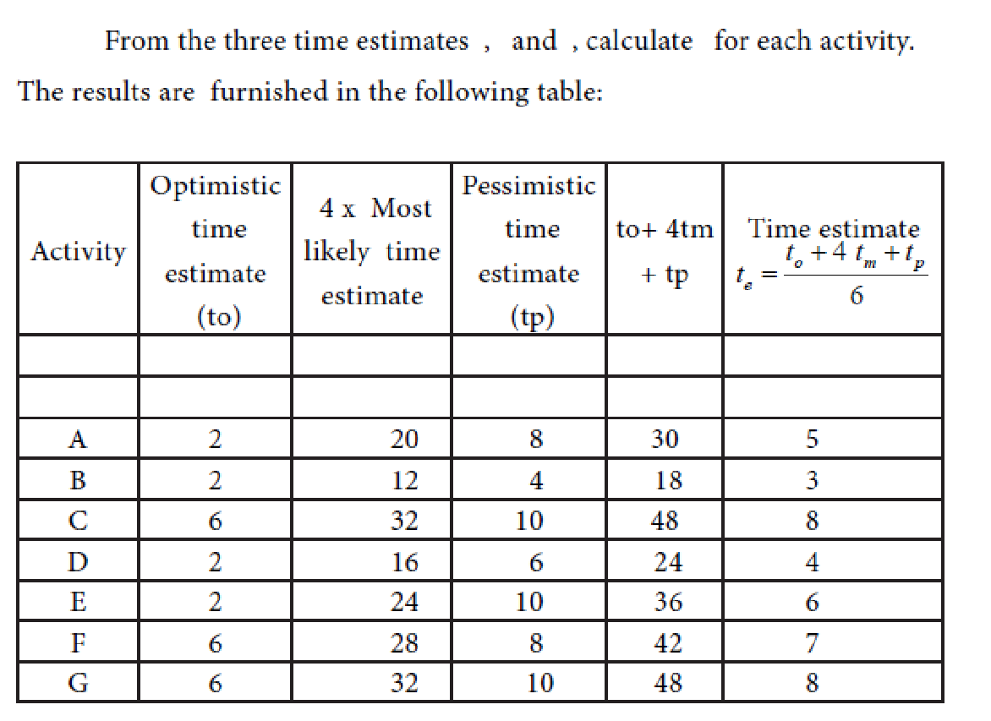

Slide 27
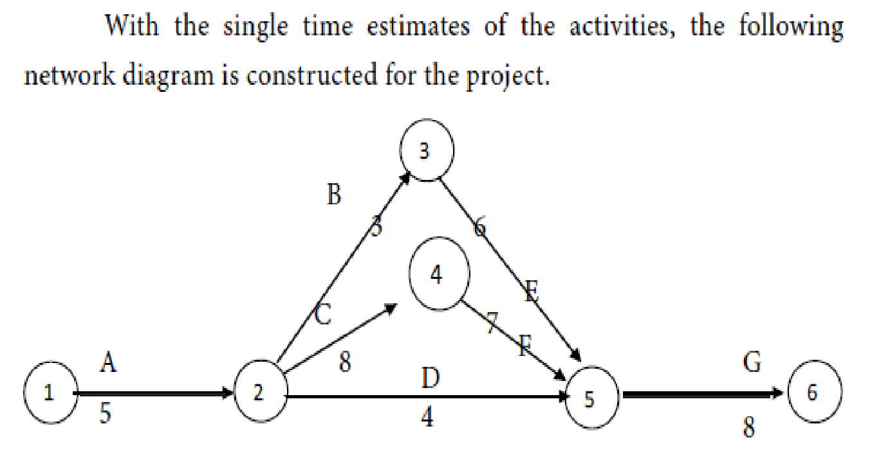
Network Diagram

Slide 28
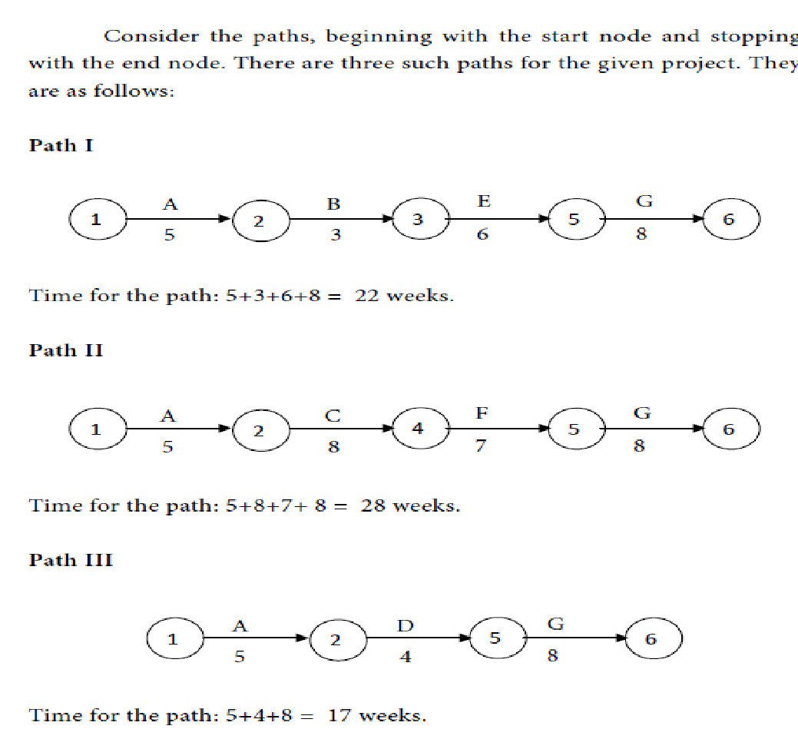
Slack of Time for each path

Slide 29
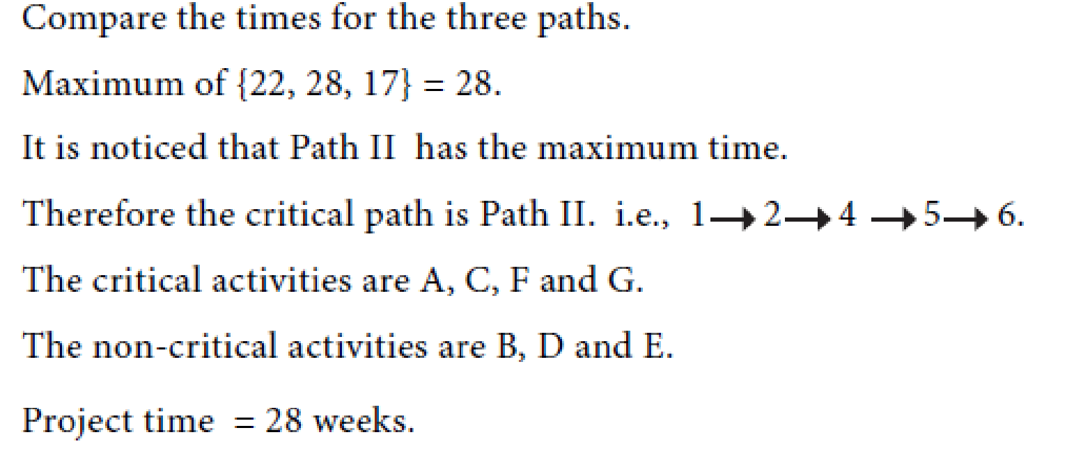
Critical Path

Slide 30
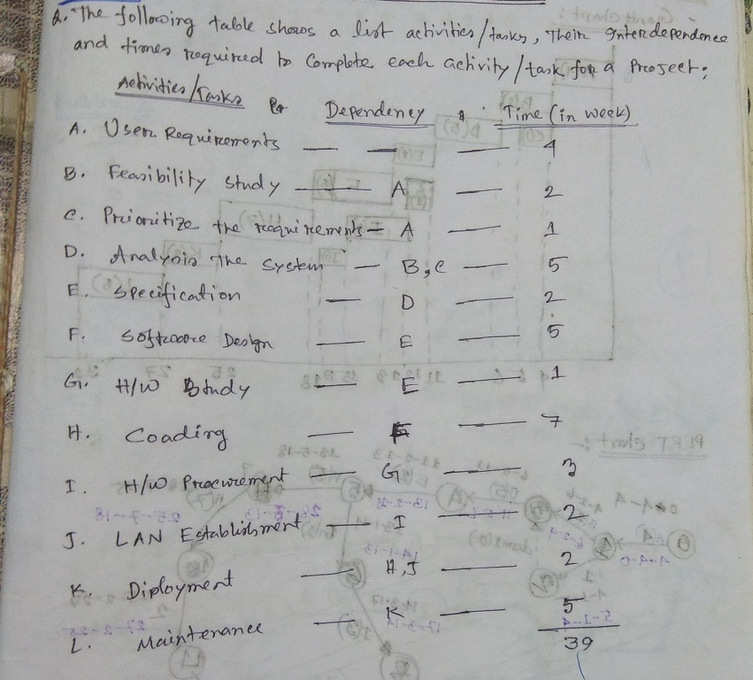
Example-1

Slide 31
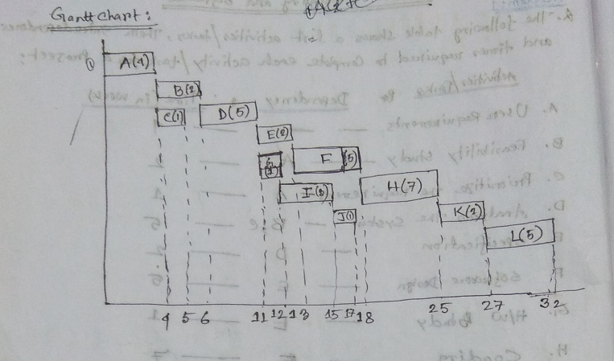
Gantt/Bar Chart

Slide 32
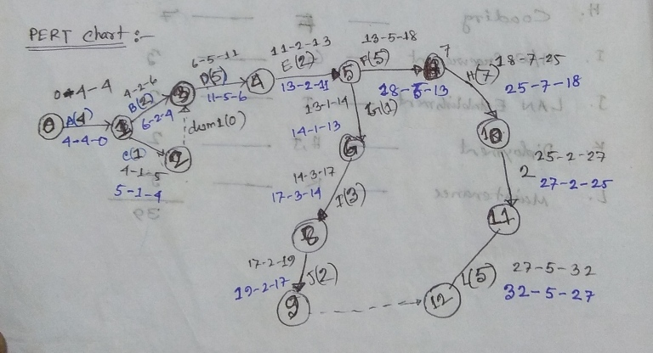
Network Diagram/PERT Chart

Slide 33
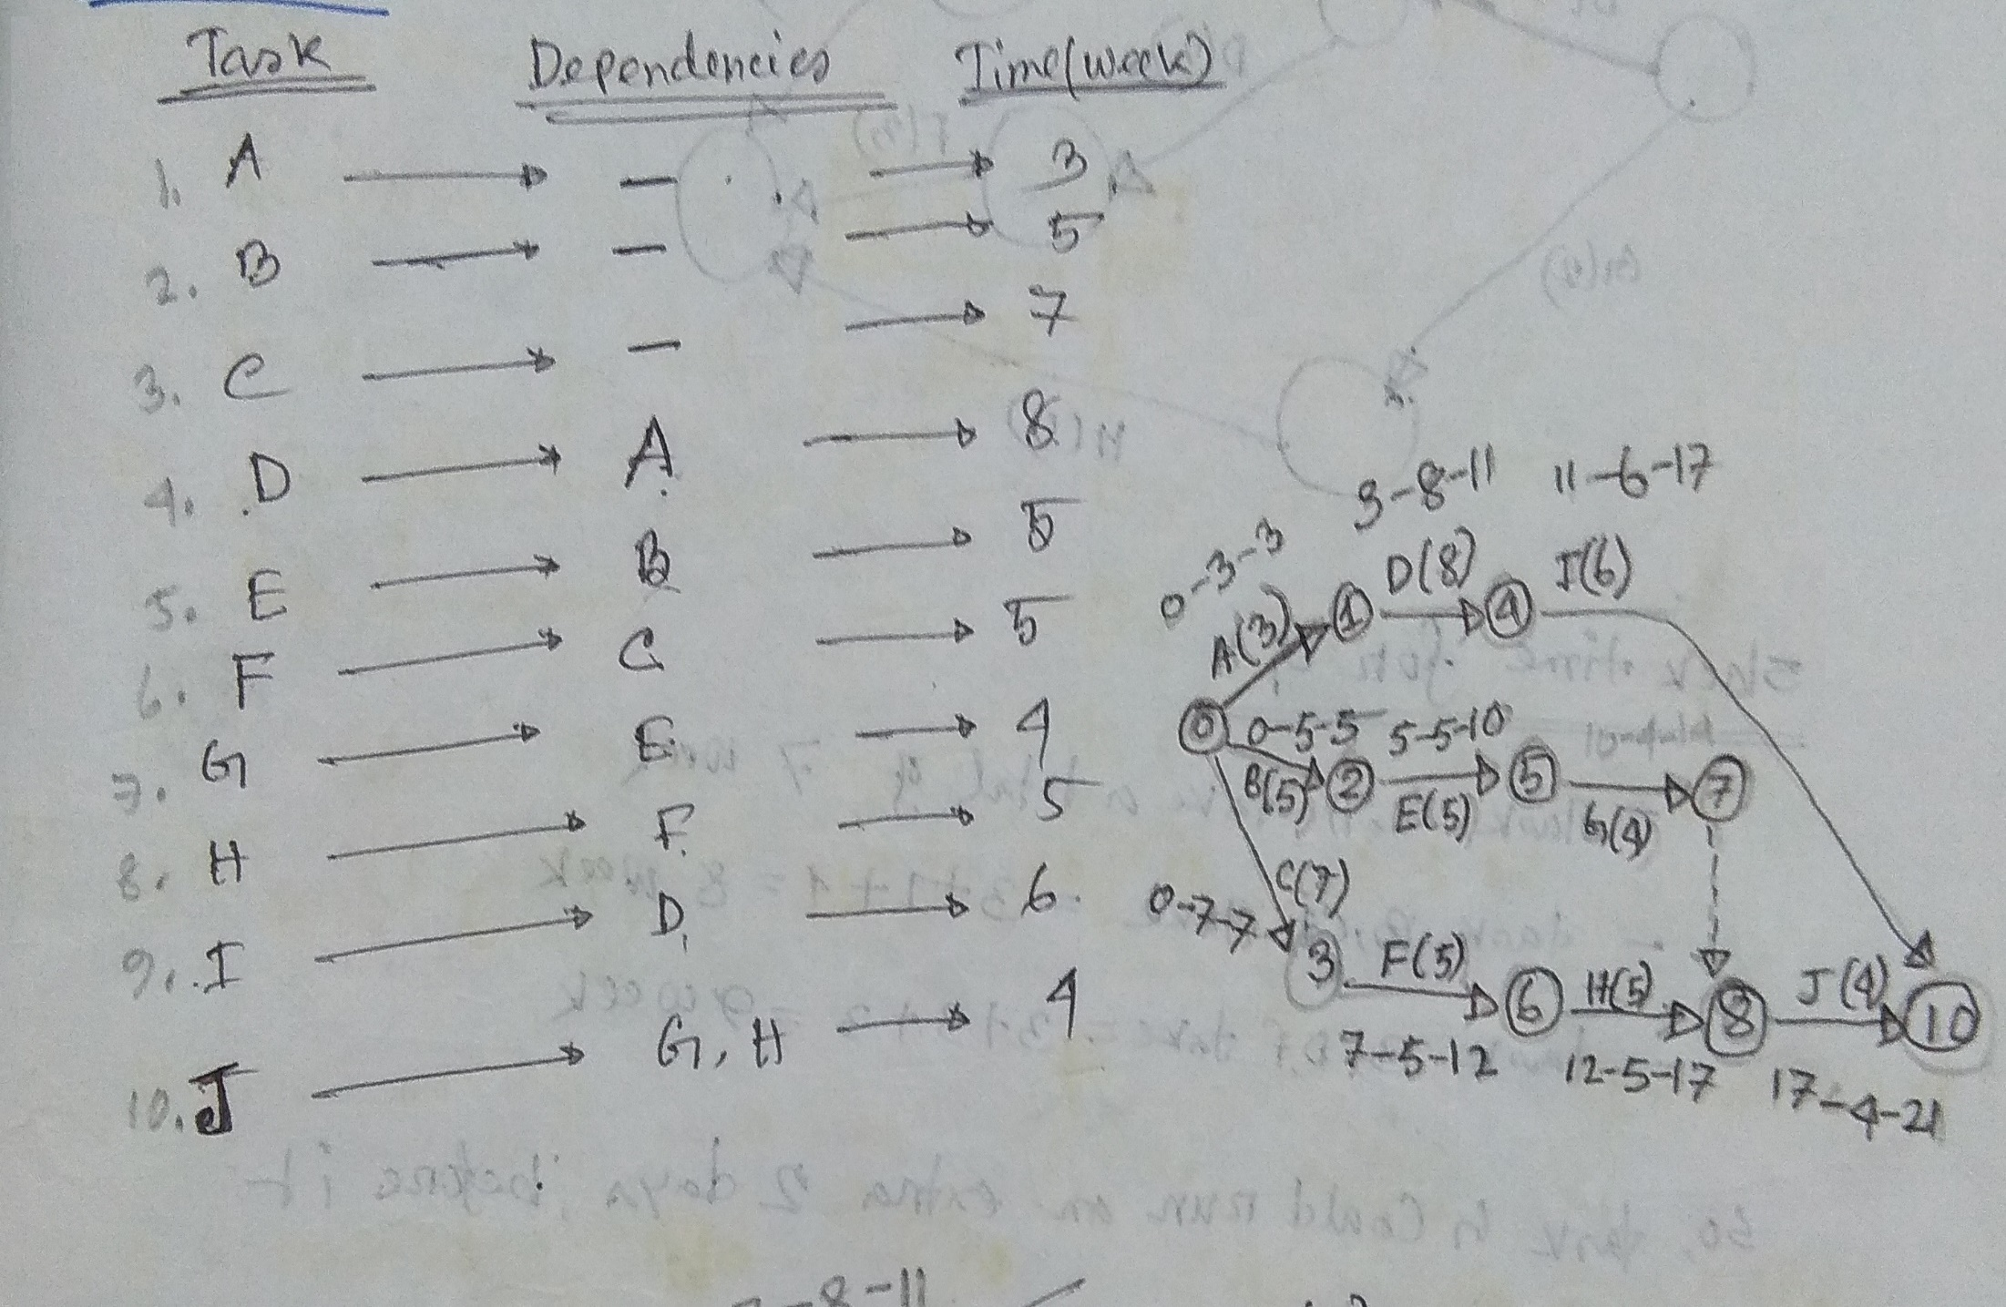
Example-2

Slide 34
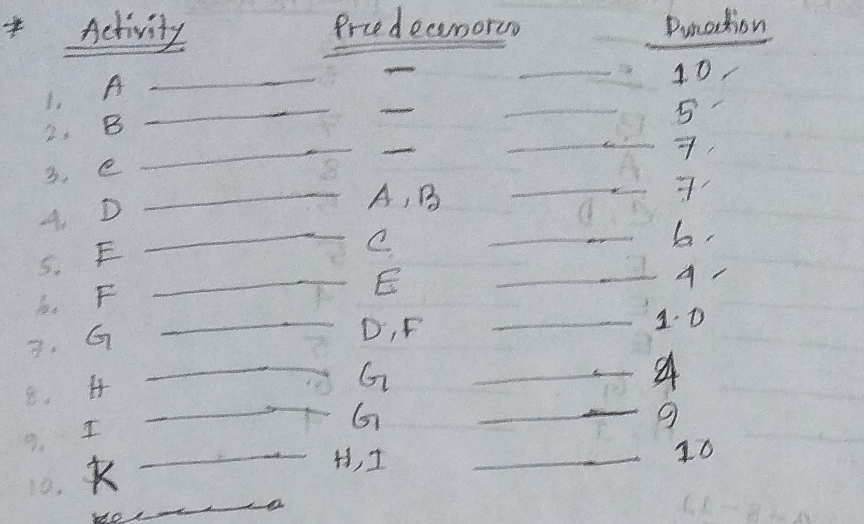
Example-3

Slide 35
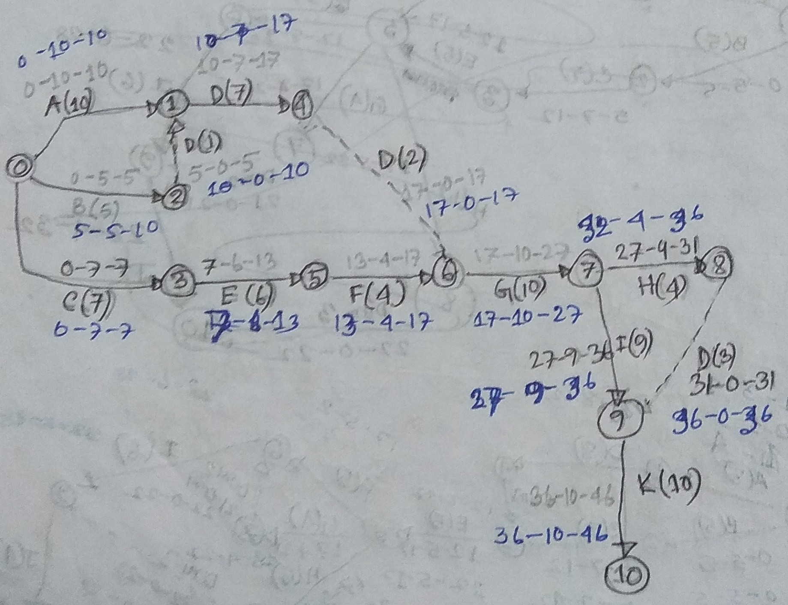
Network Diagram/PERT Chart

Slide 36
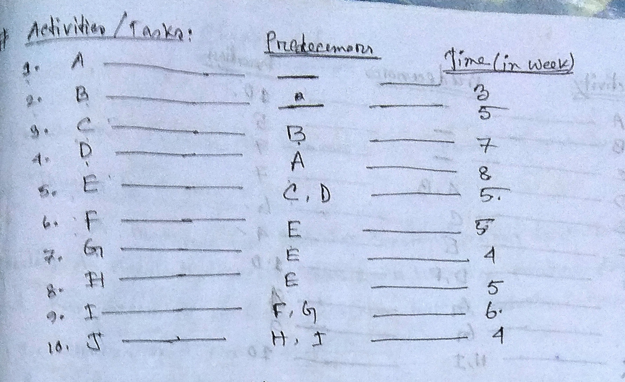
Example-4

Slide 37
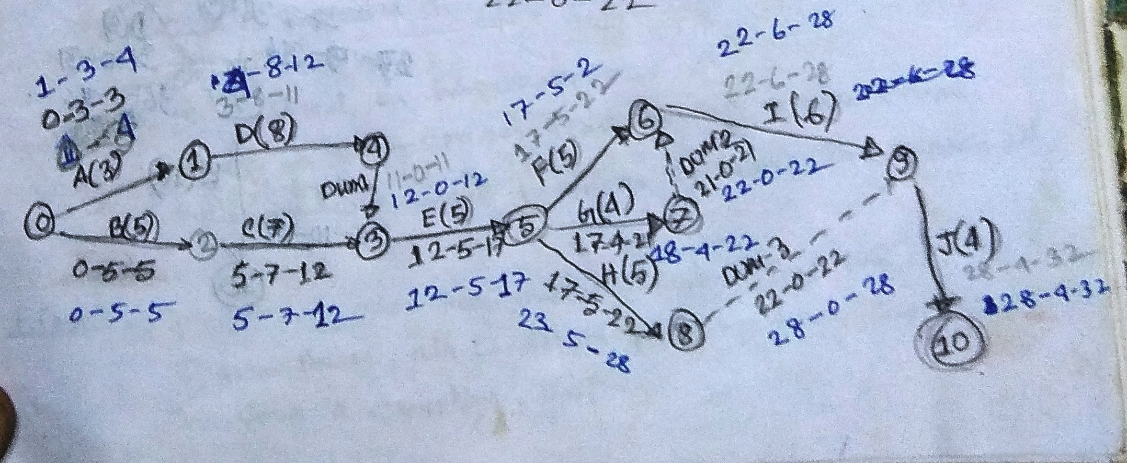
Network Diagram/PERT Chart

Slide 38
Thank You !!

